Slide 1


OHDSI Oncology WG Genomic Subgroup
Genomic-CDM Minimization
2020.02.18
Seojeong, Seng Chan

Slide 2

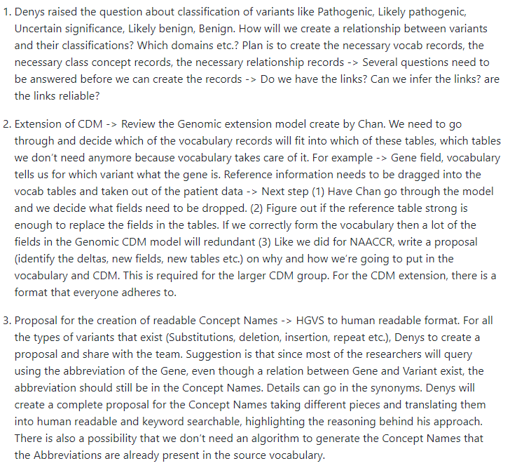
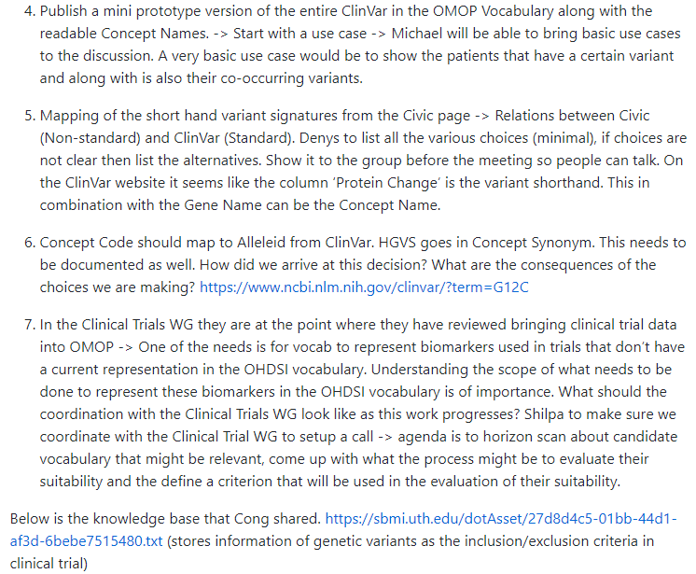
Notes:
Last week, our working group discussed about the vocabulary for expressing genomic variant and their clinical impact.

Slide 3
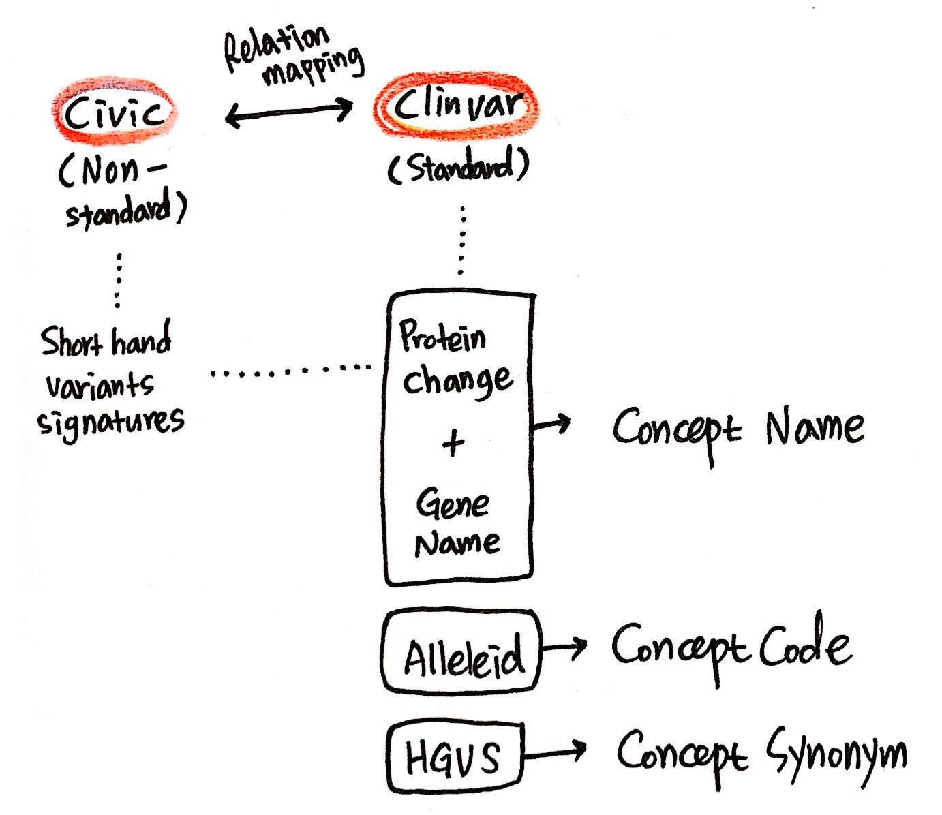
“Readable”
“Not-readable”
Notes:
As recorded in the meeting note, we'll give a combination of genetic names and changes in proteins from clinvar to make a readable concept name.
And we’ll set allele id from clinvar to a concept code. And we’ll also set HGVS expression to a concept synonym for additional information.

Slide 4
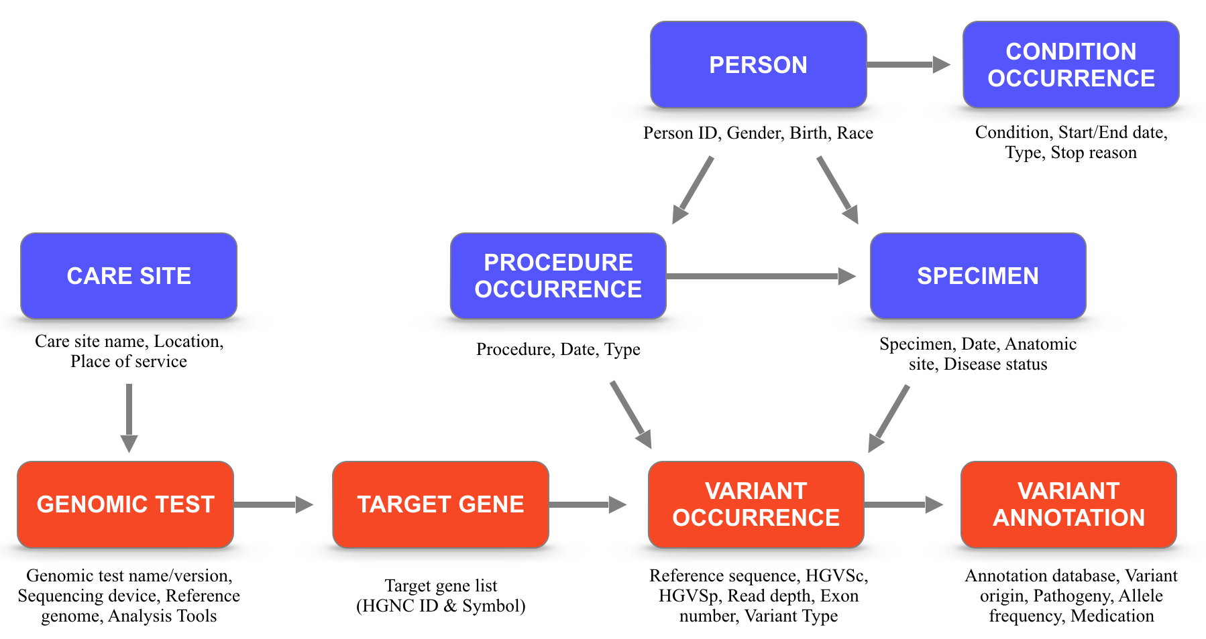
Genomic Test Process
Next Generation
Sequencing (NGS)
[Clinvar] Pathogenic
p.Leu858Arg
[PolyPhen] Damaging
Exon19 Deletion
[SIFT] Deleterious
EGFR
[GNOMAD] 0.686792
p.Thr790Met
KRAS
BRAF
Notes:
The first version of the genomic-cdm was designed under the consideration of genomic test process.

Slide 5
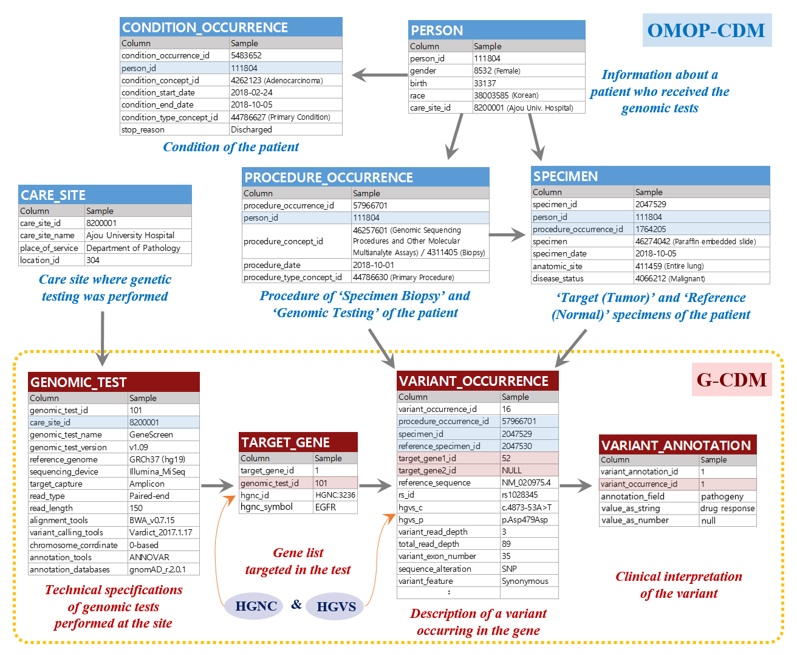
(1)
(2)
(4)
(5)
(3)
(8)
(6)
(7)
(9)
Notes:
These four genomic tables are connected to other tables of omop-cdm for storing clinical information.

Slide 6
Dropped
Merged
Dropped
Notes:
Under the situation of the new strategy of the genomic working group, we can skip genomic_test and target_gene tables in order to both minimizing the genomic-cdm and conducting use-cases efficiently.
Last two tables, variant_occurrence and variant_annotation, were merged into a table, named ‘genomic’.

Slide 7
Genomic-CDM Minimization
# | Original Field Name | Description | Edited | Altered Field Name | Editing Reason | Example
1 | variant_occurrence_id | A unique identifier for each variant occurrence event | Maintained | genomic_id | - | 7
 |  |  | Inserted | person_id | - | 10561
2 | procedure_occurrence_id | A foreign key identifier to the Procedure_occurrence table for the procedure used to obtain the specimen | Maintained | procedure_id | - | 468137
3 | specimen_id | Tumor specimen ID | Maintained | specimen_id | - | 1356798
4 | reference_specimen_id | ID of the normal specimen related to the tumor specimen | Delete | - | Table minimization | 1356799
5 | target_gene1_id | A foreign key identifier to the Target_gene table for which the variant information is recorded | Maintained | gene1 | - | HGNC:3236
6 | target_gene1_symbol | A symbol of gene where the variant information is recorded | Delete | - | Table minimization | EGFR
7 | target_gene2_id | A foreign key identifier to the Target_gene table for which the variant information is recorded when a translocation variant occurs | Maintained | gene2 | - | HGNC:6407
8 | target_gene2_symbol | A symbol of gene where the variant information is recorded | Delete | - | Table minimization | KRAS
9 | reference_sequence | Transcript ID based on a protein-coding RNA (mRNA) made up of the accession number and version number | Delete | - | Table minimization | GRCh37(hg19)
10 | rs_id | dbSNP reference ID (rsID) maintained by NCBI | Delete | - | Table minimization | rs102947
11 | reference_allele | Reference allele sequence (e.g., A) | Delete | - | Table minimization | A
12 | alternate_allele | Variant allele sequence (e.g., C) | Delete | - | Table minimization | C
13 | hgvs_c | Nomenclature for the sequence variant at the DNA level | Maintained | HGVSc | - | c.34G>C
14 | hgvs_p | Nomenclature for the sequence variant at the protein level | Maintained | Protein change | Substitute with "Protein change" | p.Gly12Arg
15 | variant_read_depth | Variant depth divided by read depth | Delete | - | Table minimization | 206
16 | variant_exon_number | Exon number in which the variant occurred | Delete | - | Table minimization | 21
17 | copy_number | Copy number value for CNV data | Maintained | copy_number | - | 3
18 | cnv_locus | Locus information for CNV | Delete | - | Table minimization | 2046588
19 | fusion_breakpoint | sequential position that fusion variant occurred | Maintained | fusion_breakpoint | - | Chr7:17130882
20 | fusion_supporting_reads | Supporting read count of the fusion | Maintained | fusion_supporting_reads | - | Chr8:34975033
21 | sequence_alteration | Structural variant type | Maintained | Consequences | - | Insertion
22 | variant_feature | Functional variant type | Maintained | Variant_type | - | Missense
23 | genetic origin | Somatic or germline origin or the variant | Delete | - | Table minimization | Somatic
24 | genotype | Allele state | Delete | - | Table minimization | Heterozygous
25 | annotation_field | Categories or database name of annotation | Moved from variant_annotation table | Clinvar_significant | Table minimization | Pathogenic
Notes:
The original genomic-cdm was edited and in the process some columns were deleted and some columns were maintained.

Slide 8
Minimized Genomic-CDM
 |  |  | SNP | CNV | TRA
# | Field | Description | Example | Example | Example
1 | genomic_id | A unique identifier for each variant occurrence event | 7 | 8 | 9
 | person_id |  | 10561 | 10561 | 10561
2 | procedure_id | A foreign key identifier to the Procedure_occurrence table for the procedure used to obtain the specimen | 468137 | 468137 | 468137
3 | specimen_id | Tumor specimen ID | 1356798 | 1356798 | 1356798
5 | gene1 | A foreign key identifier to the Target_gene table for which the variant information is recorded | HGNC:3236 | HGNC:3236 | HGNC:3236
7 | gene2 | A foreign key identifier to the Target_gene table for which the variant information is recorded when a translocation variant occurs | NA | NA | HGNC:6407
13 | HGVSc | Nomenclature for the sequence variant at the DNA level | c.34G>C | NA | NA
14 | Protein change | Nomenclature for the sequence variant at the protein level | p.Gly12Arg | NA | t(1;20)(NM_002022.2:Met1_Arg417;NM_003286.2:Ile651_Ter766)
17 | copy_number | Copy number value for CNV data | NA | 3 | NA
18 | fusion_breakpoint | sequential position that fusion variant occurred | NA | NA | Chr7:17130882
19 | fusion_supporting_reads | Supporting read count of the fusion | NA | NA | Chr8:34975033
20 | consequences | Structural variant type | Insertion | CNV | TRA
21 | variant_type | Functional variant type | Missense | Amplification | Fusion
22 | clinvar_significant | Categories or database name of annotation | Pathogenic | Likely_pathogenic | Benign
Notes:
It’s a new minimized version of the genomic-cdm.
Different columns will be used depending on the variant type.
In the case of copy number variation, ‘copy_number’ column is used.
And especially in the case of Translocation, two columns are needed to express the fusion status.
Columns for break point and supporting reads information for fusion variant are also needed.

Slide 9
Minimized Genomic-CDM
 |  |  | SNP | CNV | TRA | Negative
# | Field | Description | Example | Example | Example | Example
1 | genomic_id | A unique identifier for each variant occurrence event | 7 | 8 | 9 | 10
 | person_id |  | 10561 | 10561 | 10561 | 10561
2 | procedure_id | A foreign key identifier to the Procedure_occurrence table for the procedure used to obtain the specimen | 468137 | 468137 | 468137 | 468137
3 | specimen_id | Tumor specimen ID | 1356798 | 1356798 | 1356798 | 1356798
5 | gene1 | A foreign key identifier to the Target_gene table for which the variant information is recorded | HGNC:3236 | HGNC:3236 | HGNC:3236 | HGNC:6915
7 | gene2 | A foreign key identifier to the Target_gene table for which the variant information is recorded when a translocation variant occurs | NA | NA | HGNC:6407 | NA
13 | HGVSc | Nomenclature for the sequence variant at the DNA level | c.34G>C | NA | NA | NA
14 | Protein change | Nomenclature for the sequence variant at the protein level | p.Gly12Arg | NA | t(1;20)(NM_002022.2:Met1_Arg417;NM_003286.2:Ile651_Ter766) | NA
17 | copy_number | Copy number value for CNV data | NA | 3 | NA | NA
18 | fusion_breakpoint | sequential position that fusion variant occurred | NA | NA | Chr7:17130882 | NA
19 | fusion_supporting_reads | Supporting read count of the fusion | NA | NA | Chr8:34975033 | NA
20 | consequences | Structural variant type | Insertion | CNV | TRA | Negative
21 | variant_type | Functional variant type | Missense | Amplification | Fusion | Negative
22 | clinvar_significant | Categories or database name of annotation | Pathogenic | Likely_pathogenic | Benign | NA
Notes:
As Christian mentioned, we need a method to store the negative information.
When there is no variant result of KRAS G12C in the genomic-cdm, how can we convince that the variant was not detected through the NGS panel for real?
There is a possibility that the NGS panel isn’t targeting the KRAS gene from the beginning.
So we can address the negative result by adding the rows for negative variant like this.

Slide 10
End of the document

